Slide 1
FLS Unit 13
Johnny Vogt

Slide 2
Quick Quiz Questionnnns
1. A
2. B
3.d
4. B….. lol, It’s C

Slide 3
Scatterplot indications for Age, SBP, and Weight.
There seems to be a Positive correlation between each of the variables. As Age increase so does the Systolic blood pressure and weight, along with Weight, As the weight increases there seems to be a trend that the age rises and so does the SBP.

Slide 4
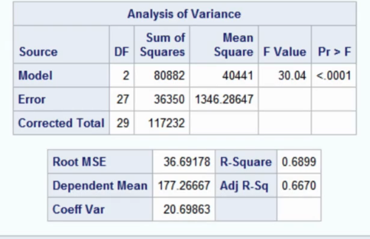
Are age and weight good predictors for the Systolic Blood Pressure
Using the output from SAS, Since the model was fitted using age and weight, The “Pr > F” is way below .05, assuming that the signifcance level is set to .05. The p-value indicates that model with age and weight are statistically significant enough assume that they are good predictors for the Systolic blood pressure.

Slide 5
Regression Equation
SBP = β0 + β1(Age) +β2(Weight)
SBP = -28.046 + 2.1609(Age) + 0.4897(Weight)
β1 is the slope for the age, for every year that person grows the mean systolic blood pressure increases by 2.1609 assuming that the weight is controlled.
β is the slope for the Weight variable. Every unit of measurement that increases in weight, the Systolic blood pressure increases by 0.4897, assuming that the age is controlled.

Slide 6
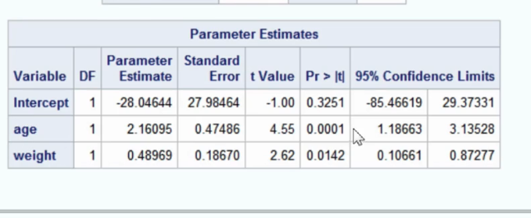
T Test and Conf Int. for age
2.16095/0.47486 = 4.5507
2.16095 +/- 4.5507*0.17486
  2.16095 +/- 0.795735402
  (-2.956685402,-1.365214598)
Tstat = Estimated Slope / Standard Error
Conf Int = Estimate +/- Tstat * SE

Slide 7
Is the linear model appropriate based on residual plots
The residual plots for both age and weight have points that are random and no discernable pattern that we are confident are part of a larger pattern. There is no curve or “fan” shape or noticeable trends. There may be a question of clustering for the weight residuals, but not enough data to suggest that this is a pattern rather than coincedence.

Slide 8
Takeaways
I thought I understood how to write out the regression equations in words, but I keep getting it wrong slightly
This ANOVA table keeps coming back huh? Lol
I think I understood why the AnoVa table mean at LEAST one variable of the predictors is useful.
These things, I feel like I understand them when someone explains it, but I don t retain it in my head.
Sorry, I didn’t mean not to have takeaways.

